Slide 1
A Randomized Trial of Continuous Noninvasive Blood Pressure Monitoring During Noncardiac Surgery
R2สุพฤกษ์ /อ.ณัฐธพงษ์

Slide 2
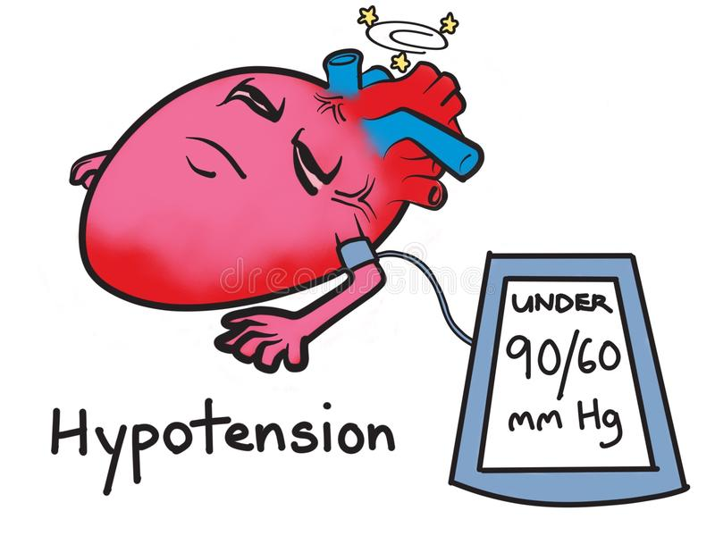
Introduction
Intraoperative hypotension is strongly associated with postoperative mortality
Notes:
Intraoperative hypotension is strongly associated with postoperative mortality. For example, hypotension was the most important factor responsible for postoperative mortality in the Perioperative Ischemia
Evaluation Trial.1 Many other studies similarly report strong associations between hypotension and postoperative acute kidney injury (AKI) and myocardial injury

Slide 3

Introduction

Slide 4
Introduction
Optimizing intraoperative hemodynamics and avoiding hypotension may reduce perioperative myocardial and renal injury

Slide 5
Introduction
Intraoperative hypotension has various definitions
Mean arterial pressure (MAP) <65 mm Hg has been associated with worse outcomes

Slide 6
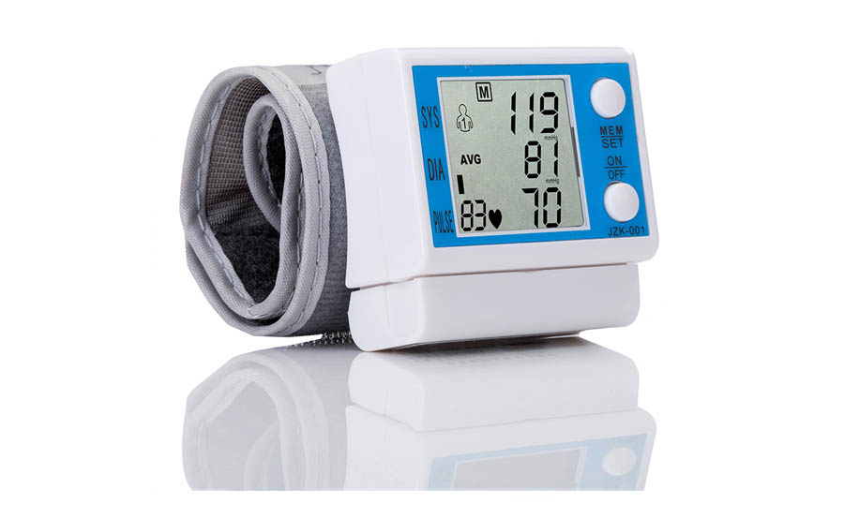
Introduction
Intraoperative blood pressure : noninvasive oscillometric devices every 3–5 minutes

Slide 7
Introduction
An alternative is noninvasive finger cuff monitoring which can provide continuous hemodynamic monitoring
The system provides continuous beat-to-beat blood pressure, along with stroke volume, stroke volume variation, cardiac output, and systemic vascular resistance

Slide 8
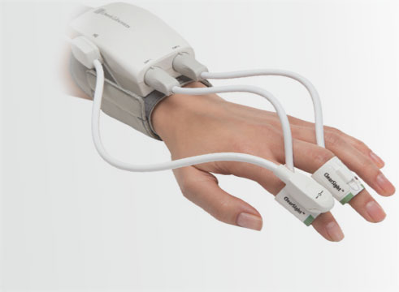
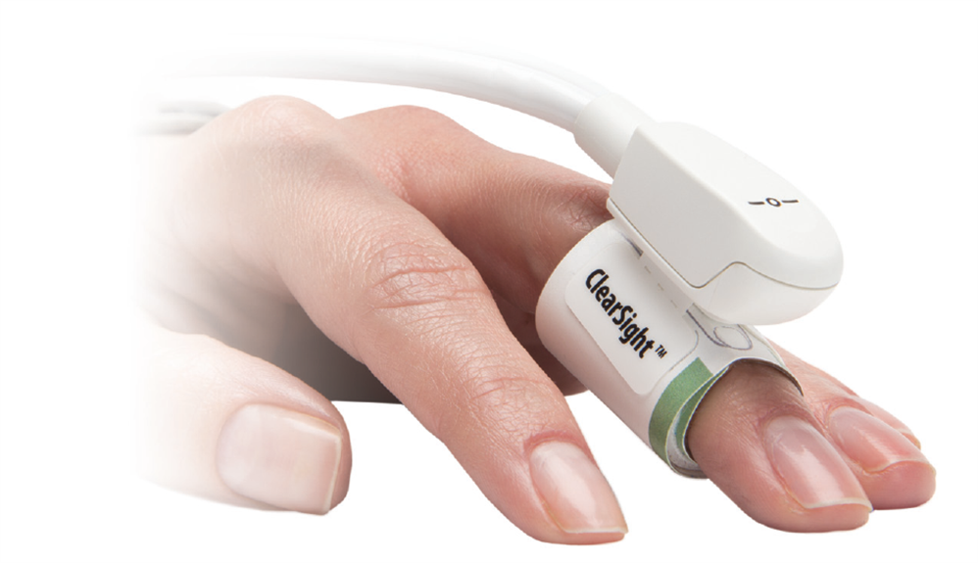
Introduction
The ClearSight (Edwards Lifesciences Corp, Irvine, CA)

Slide 9
Introduction
Hypothesis :
Continuous noninvasive monitoring of blood pressure in moderate-to-high-risk surgical patients reduces the duration and severity of intraoperative hypotension compared to intermittent NIBP

Slide 10
Methods
Study was approved by the Cleveland Clinic Institutional Review Board
Informed consent from all subjects participants
The trial was registered at clinicaltrials.gov

Slide 11
Methods
enrolled 320 adults
Inclusion criteria :
45 years or older
ASA III or IV
noncardiac surgery with general anesthesia
Notes:
is a continuous noninvasive hemodynamic monitor which uses volume clamp and physiocal methods.1

Slide 12
Methods
Exclusion criteria :
  Invasive arterial monitoring was needed (by anesthesiologist)
  >10% discrepancy in preoperative MAP between arms
  The expected duration of surgery was <2 hours

Slide 13
Methods
Patients were randomly allocated to continuous unblinded or blinded continuous monitoring by an investigator not involved in clinical care
1:1 ratio, computer-generated random number via a web-based system (REDCap secure web application)

Slide 14
Methods
The continuous monitor was placed on all patients in addition to the intermittent oscillometric cuff on opposite arms

Slide 15
Methods
continuous monitoring group
  Information from the continuous monitor was available to the clinicians in addition to the usual oscillometric values
blinded group
  blood pressure management was based only on intermittent oscillometric BP monitoring
  the information from continuous monitors was not available to the clinicians but recorded for analysis purposes

Slide 16
Methods
Induction in all patients
  Standard monitoring
  etomidate (0.2–0.3 mg/kg) or propofol (1–2 mg/kg)
  vecuronium (0.1 mg/kg) or rocuronium (0.6 mg/kg)
  fentanyl (1–2 μg/kg)
Notes:
(electrocardiography, noninvasive blood pressure, oxygen saturation, temperature

Slide 17
Methods
in all patients
Inhalation anesthetics (up to 1.5 MAC)
50%–80% inspired oxygen and air

Slide 18
Methods
Clinicians were thus free to use
  type and amount of intravenous fluids
  dose of vasopressors and inotropes
  adjust the inhalational concentration
  intravenous anesthetic drugs

Slide 19

Methods
TWA MAP under a threshold of 65 mm Hg was calculated as the area between 65 mm Hg threshold and the curve of the MAP measurements divided by total continuous reading time:
Notes:
TWA is similar to an ordinary arithmetic mean, except that instead of each of the MAP measures contributing equally to the final average, some MAP measures contributed more than others

Slide 21
Methods
AKI
AKIN classification, modified per Walsh to exclude urine output
We also extended the normal 48-hour creatinine window used in the AKIN criteria to 7 days to better characterize the postoperative period

Slide 22
Methods
Quality of recovery (QOR-15) and postoperative morbidity survey (POMS)
  on the third postoperative day or at discharge
Notes:
based on which occurrence came first, by a blinded research fellow

Slide 23
Methods
Quality of recovery (QOR) :
  emotional state
  physical discomfort
  psychological support
  physical independence
  pain

Slide 24
Methods
Postoperative morbidity survey (POMS) :
  18-item survey that addresses 9 domains of postoperative morbidity
  reliable and valid descriptor of short-term postoperative morbidity

Slide 25
Statistical Analysis
For primary analysis, 2 randomized groups were compared on the TWA MAP <65 mm Hg
2-sample Wilcoxon rank-sum test and Hodges Lehmann estimation of location shift with corresponding asymptotic 95% CI
the primary result was adjusted for slightly imbalanced age and type of surgery via multivariable generalized linear model with logit link function

Slide 26
Statistical Analysis
2 secondary analyses, in which the outcomes TWA MAP under MAP <60 mm Hg
and MAP <55 mm Hg

Slide 27
Statistical Analysis
Six exploratory outcomes including
  transfusion requirement
  AKI
  in-hospital composite of death,stroke, or myocardial injury after noncardiac surgery
  QOR score
  POMS
  hospital lengths

Slide 28
Results

Slide 29
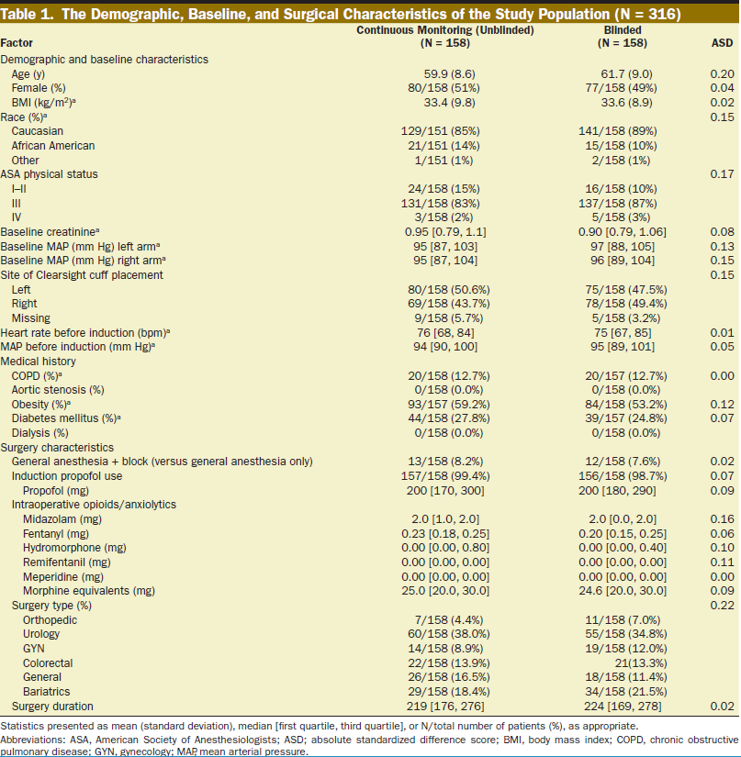
Results

Slide 30

Results

Slide 31
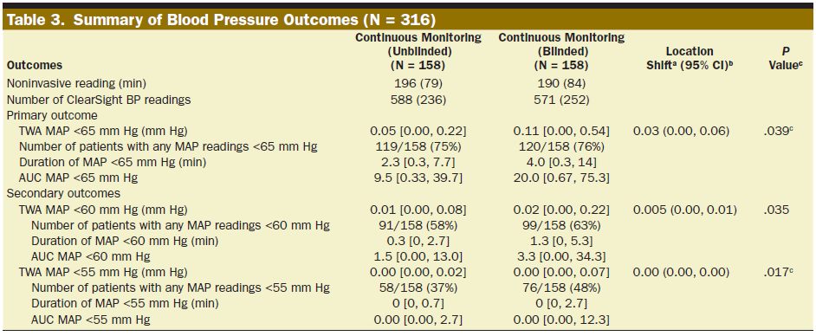
Results

Slide 32
Results

Slide 33
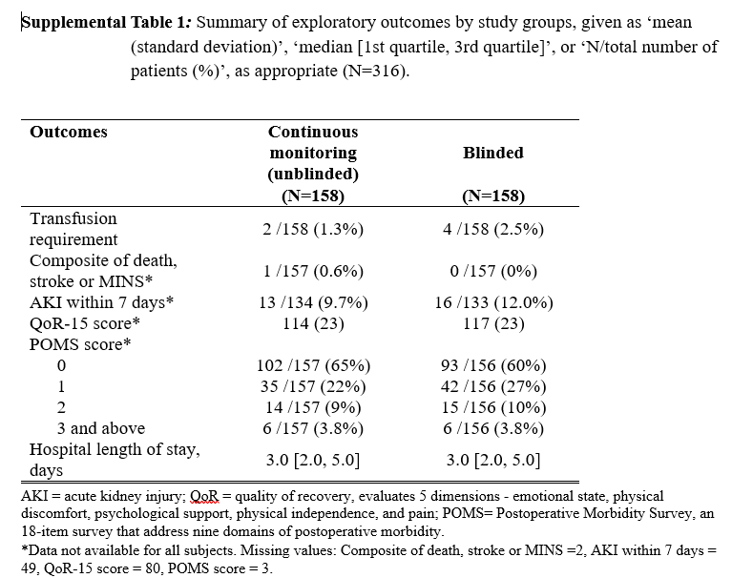
Results

Slide 34

Discussion
Continuous noninvasive blood pressure monitoring in moderate-to-high-risk surgical patients reduced the duration and severity of hypotension
The median time spent <65 mm Hg was nearly halved (2 vs 4 minutes)
in the continuous monitoring group
Notes:
although we did not formally compare the 2 groups on duration of hypotension outcome

Slide 35
Discussion
The amounts of hypotension were also lower under thresholds of 60 and 55 mm Hg in the continuous monitoring group
The differences in TWA MAP are relatively small but even few minutes
of extra hypotension is associated with worse outcome
Notes:
For example, just a single minute at a MAP of 50 mm Hg
increases the risk of mortality 5%.10

Slide 36
Discussion
The results are consistent with Meidert et al
Randomized 160 orthopedic surgery patients to continuous blood pressure monitoring or monitoring every 3 minutes
continuous monitoring improved hemodynamic stability
Notes:
However, Meidert et al18 used the oscillometric blood pressure values every 3 minutes for the first hour of general anesthesia; in contrast, we compared continuous blood pressure measurements every 20 seconds
throughout surgery.

Slide 37
Discussion
The TWA <65 of 0.11 mm Hg in the oscillometric group means that the average patient had an exposure 0.11 mm Hg below 65 mm Hg throughout surgery.
With an average case duration in the study of nearly 4 hours, a TWA MAP of 0.11 corresponds to 0.11 mm Hg times 240 minutes = 26 mm Hg ×minutes.
In this example, 26 mm Hg x minutes could refer to a patient who spent 13 minutes at 63 mm Hg or approximately 4 minutes at 59 mm Hg

Slide 38
Discussion
Once hypotension is detected, the optimal treatment is often unclear and depends on numerous factors
Advanced hemodynamic parameters can guide management of hypotension

Slide 39
Discussion
The impact of continuous monitoring may have been limited by lack of set protocol for hypotension management
Clinicians may also have mistrusted the accuracy of ClearSight blood pressure and ancillary measurements, despite good validation

Slide 40
Discussion
In summary, continuous noninvasive blood pressure monitoring nearly halved the amount of intraoperative hypotension in adults having noncardiac surgery
Because continuous monitoring allowed clinicians to detect hypotension earlier and respond effectively

Slide 41
Discussion
Avoiding hypotension may well reduce the incidence of serious complications

Slide 42
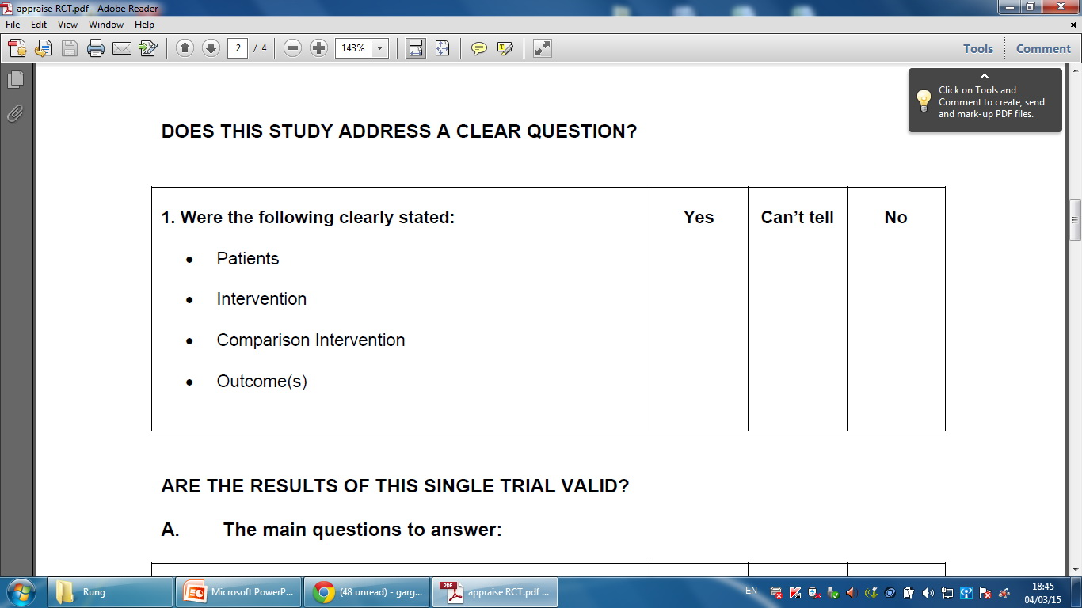
Critical Appraisal
Does this study address a clear question?

Slide 43
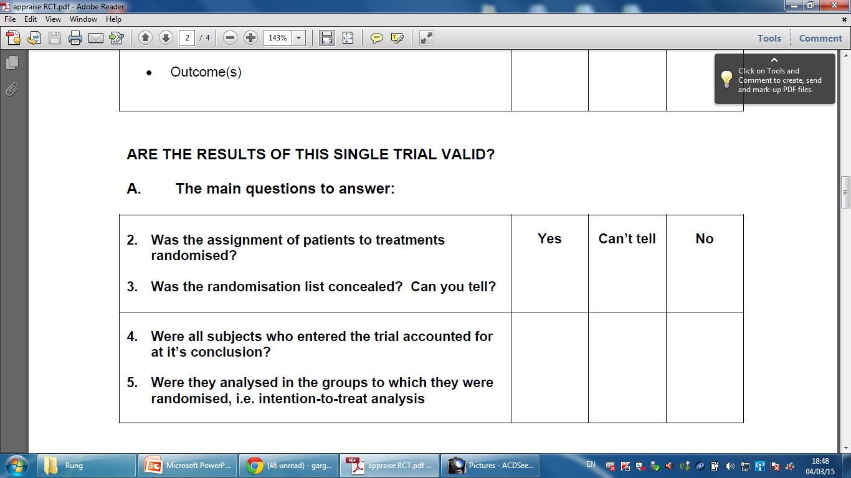
Critical Appraisal
Are the results of this single trial valid?
Notes:
คิดตามสิ่งที่เราตั้งใจจะให้เขาทำตั้งแต่แรก ก็คือไม่ว่าคุณจะเอายากลับไปกินหรือไม่กิน เราก็จะถือว่าคุณอยู่ในกลุ่มยา เรียกว่าแบบ intention-to-treat
ข้อที่ดีกว่าเป็นอย่างมากของแบบที่สองนี้คือว่ามันยังรักษาความที่มันเกลี่ย ลักษณะที่เรา random ไว้ตั้งแต่แรกไว้ด้วยครับ ดังนั้นหากไม่มี intention to treat แล้วจริงๆ ก็ไม่รู้ว่าจะ randomize ไปทำไม ทำให้ขาดความน่าเชื่อถือไปเป็นอย่างมากครับ ซึ่งโดยส่วนใหญ่เดี๋ยวนี้ผู้วิจัยก็รู้กันและจะทำการวิเคราะห์แบบ intention-to-treat อยู่แล้ว ยกเว้นผู้วิจัยกลุ่มเล็กๆ ที่ยังไม่เคยรู้จัก EBM ครับ

Slide 44
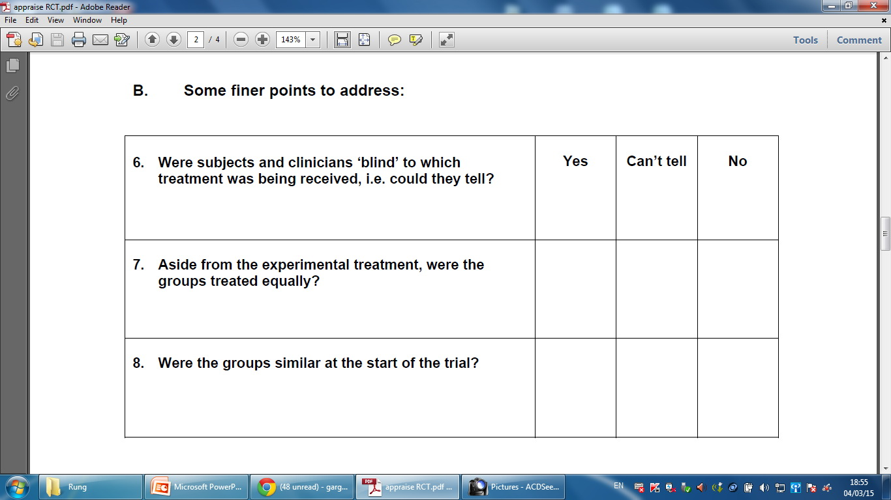
Critical Appraisal
Are the results of this single trial valid?

Slide 45
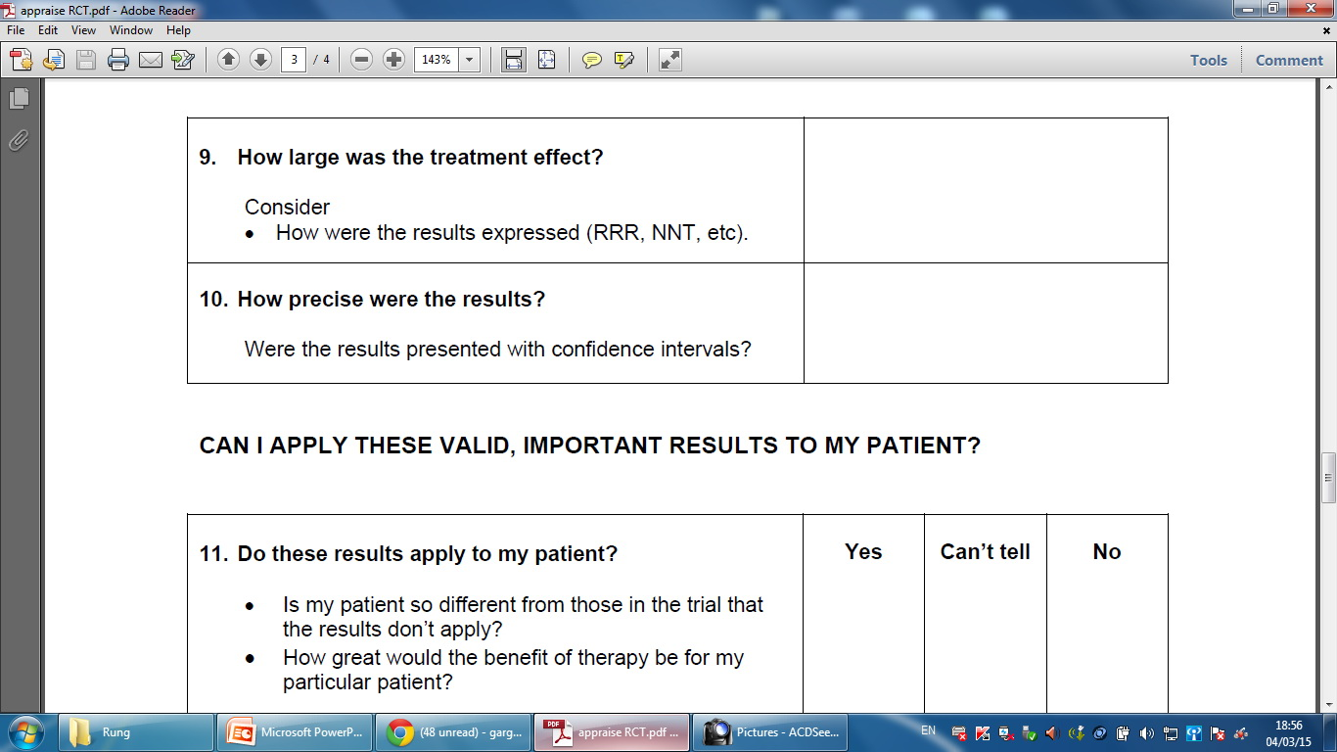
Critical Appraisal
0.05 [0.00, 0.22]vs 0.11 [0.00, 0.54]
P value = 0.039
-
Yes
Notes:
Primary outcome
TWA MAP <65 mm Hg (mm Hg)

Slide 46
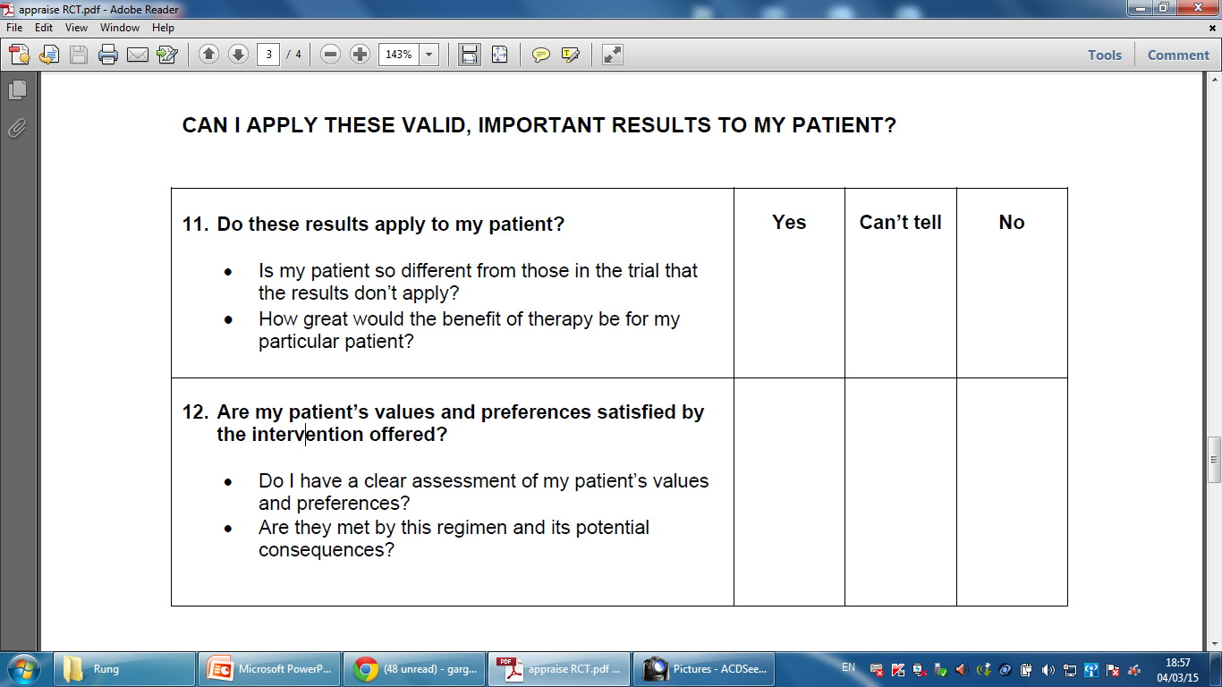
Critical Appraisal : RCT
Can I apply these valid, important results to my patients?

